Slide 1
Foreign Direct Investment Analytics

Slide 2
Problem Statement:
Investment is a game of understanding historic data of investment objects under different events but it is still a game of chances to minimize the risk we apply analytics to find the equilibrium investment. To understand the Foreign direct investment in India for the last 17 years from 2000-01 to 2016-17. This dataset contains sector and financial year-wise data of FDI in India Sector-wise investment analysis Year-wise investment analysis. Find key metrics and factors and show the meaningful relationships between attributes.

Slide 3
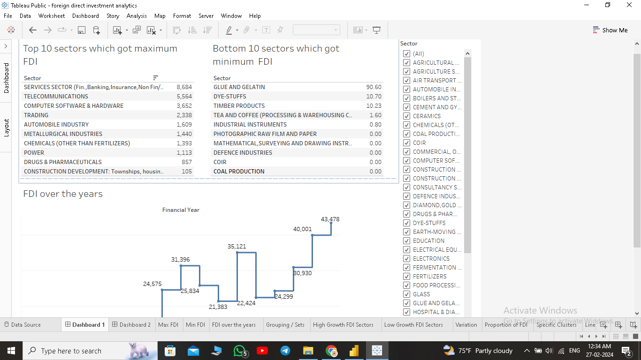

Slide 4
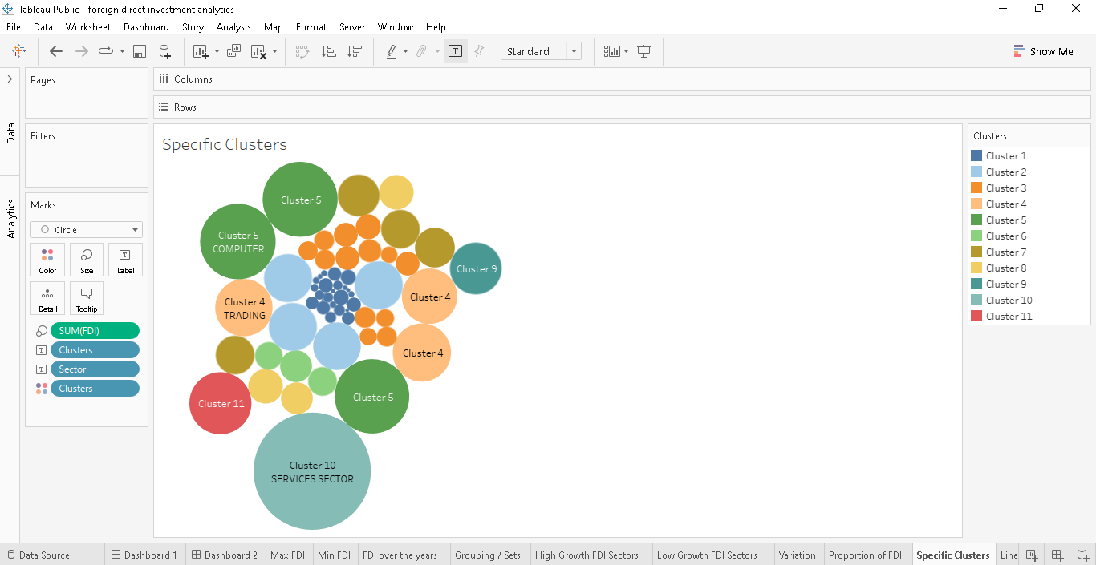

Slide 5
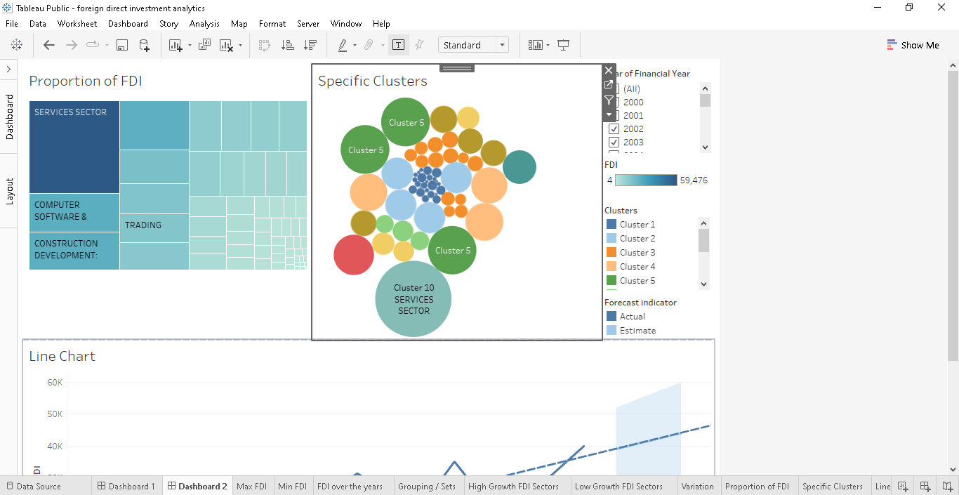

Slide 6
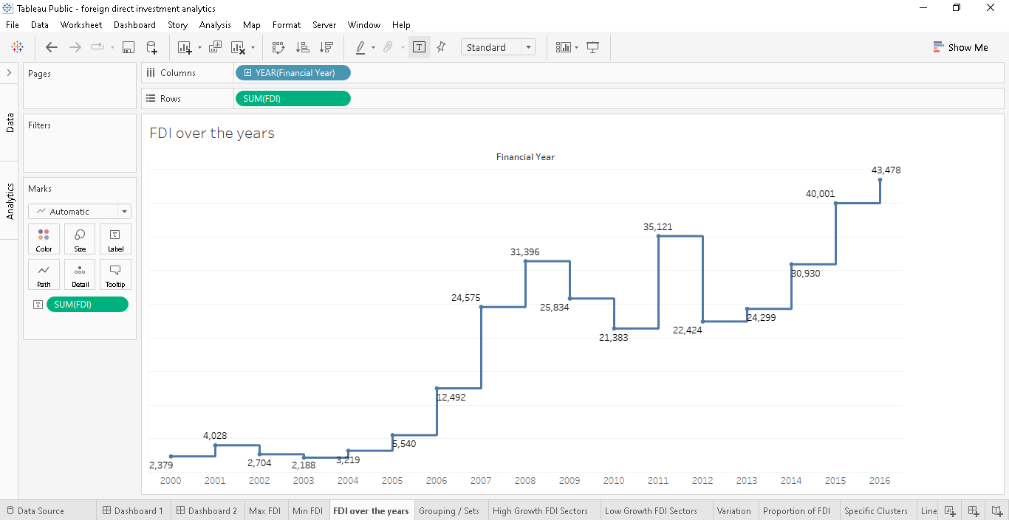

Slide 7
Thank You

